Slide 1
BAConnect
By: Alexander Bridges, Jonathan Young, Eric Strayer, and Jacob Hu

Slide 2
Admin-end activities
http://baconnect.tk/
Notes:
Jonathan made this.

Slide 3
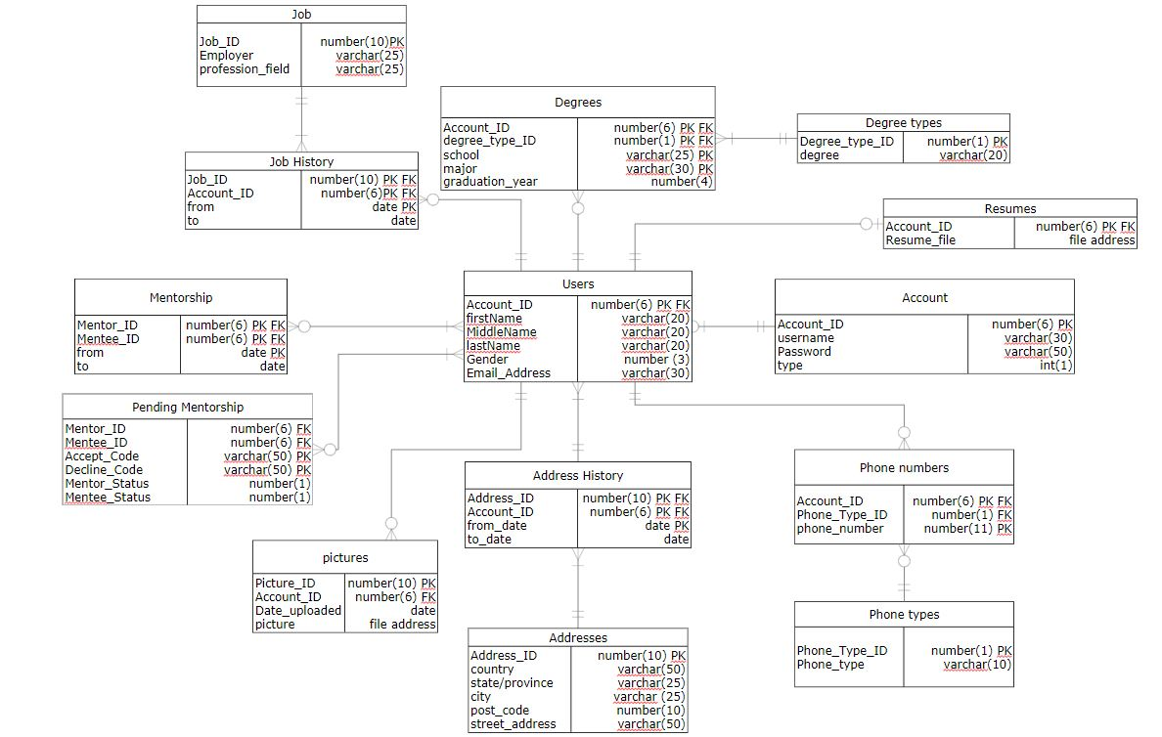
Database Design
Notes:
Eric made most of on his own, with some alterations suggested by Alexander and Jonathan.

Slide 4
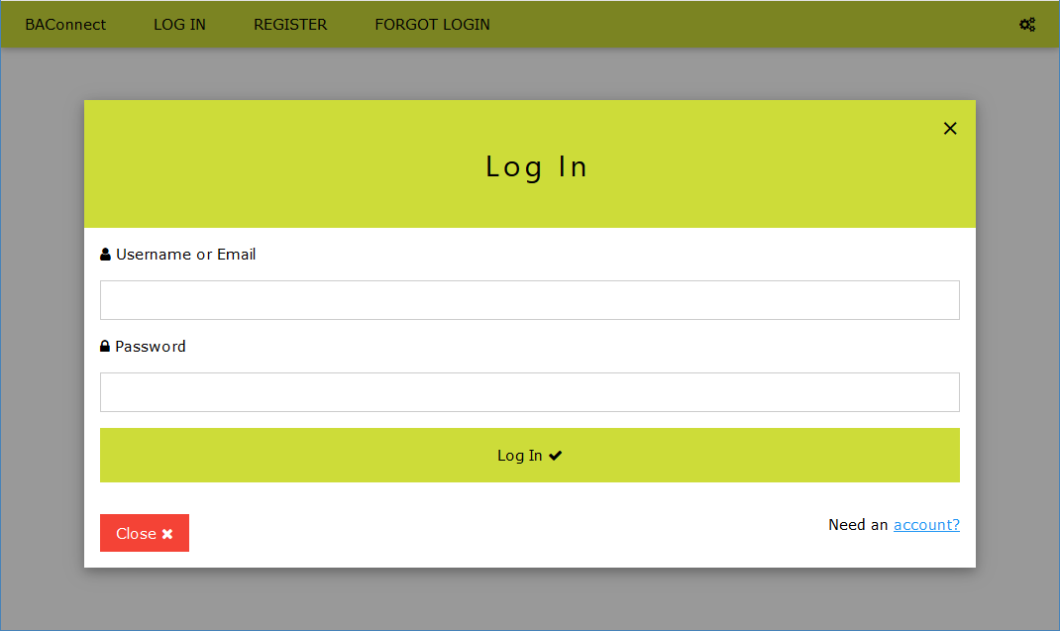
Login page
Notes:
Eric made the input boxes and label text. Alexander plugged that into a window, and applied the style.

Slide 5
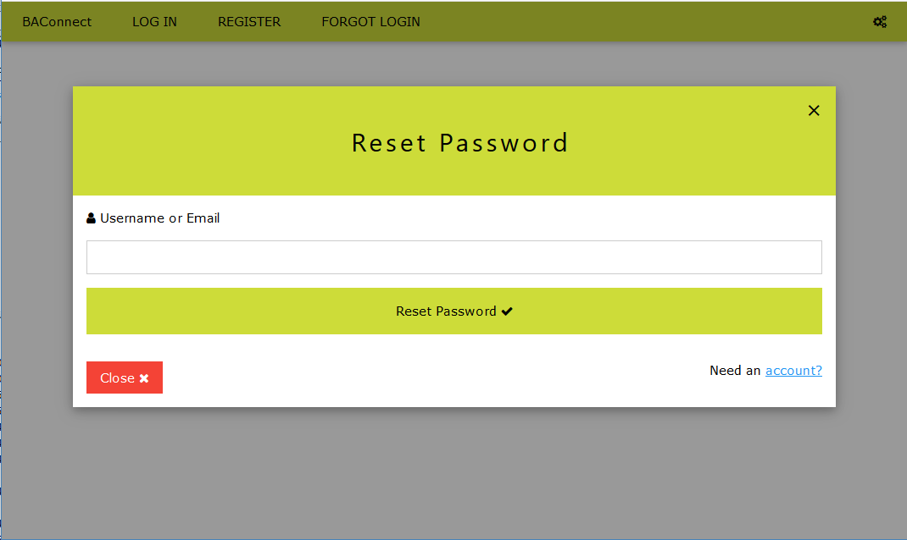
Reset Password Page
Notes:
Alexander was here

Slide 6
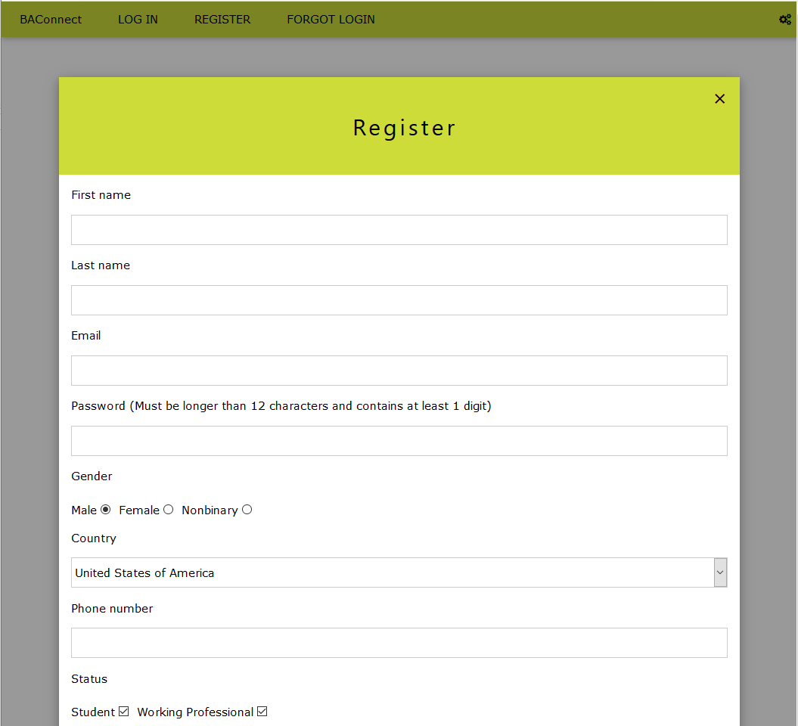
Notes:
Eric made all the input boxes and buttons. Alexander got the add degree and remove degree buttons to work, with assistance from Jonathan. Alexander also made the header visible in the background, and the window the form is displayed in.

Slide 7
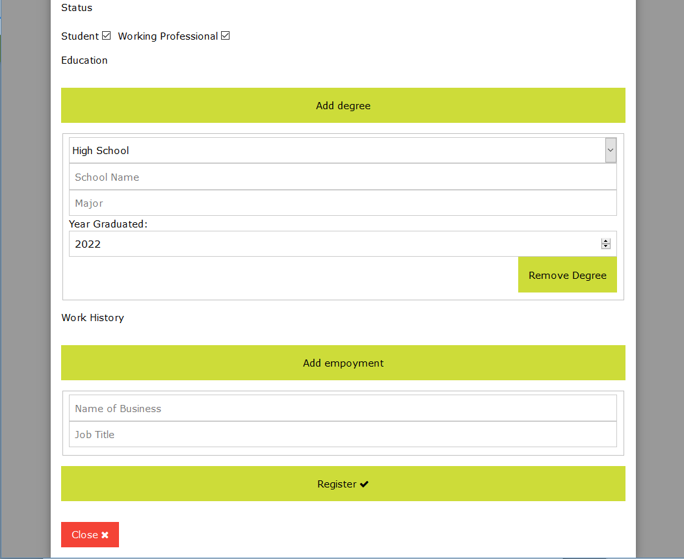
Notes:
Eric made all the input boxes and buttons. Alexander got the add degree and remove degree buttons to work, with assistance from Jonathan. Alexander also made the header visible in the background, and the window the form is displayed in.

Slide 8
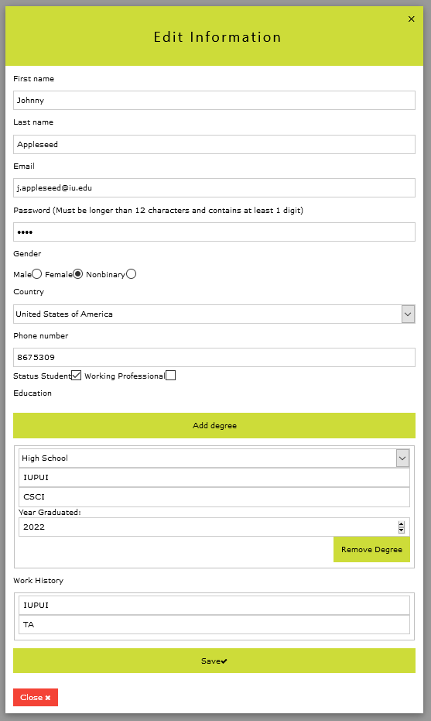

Slide 9
